Slide 1
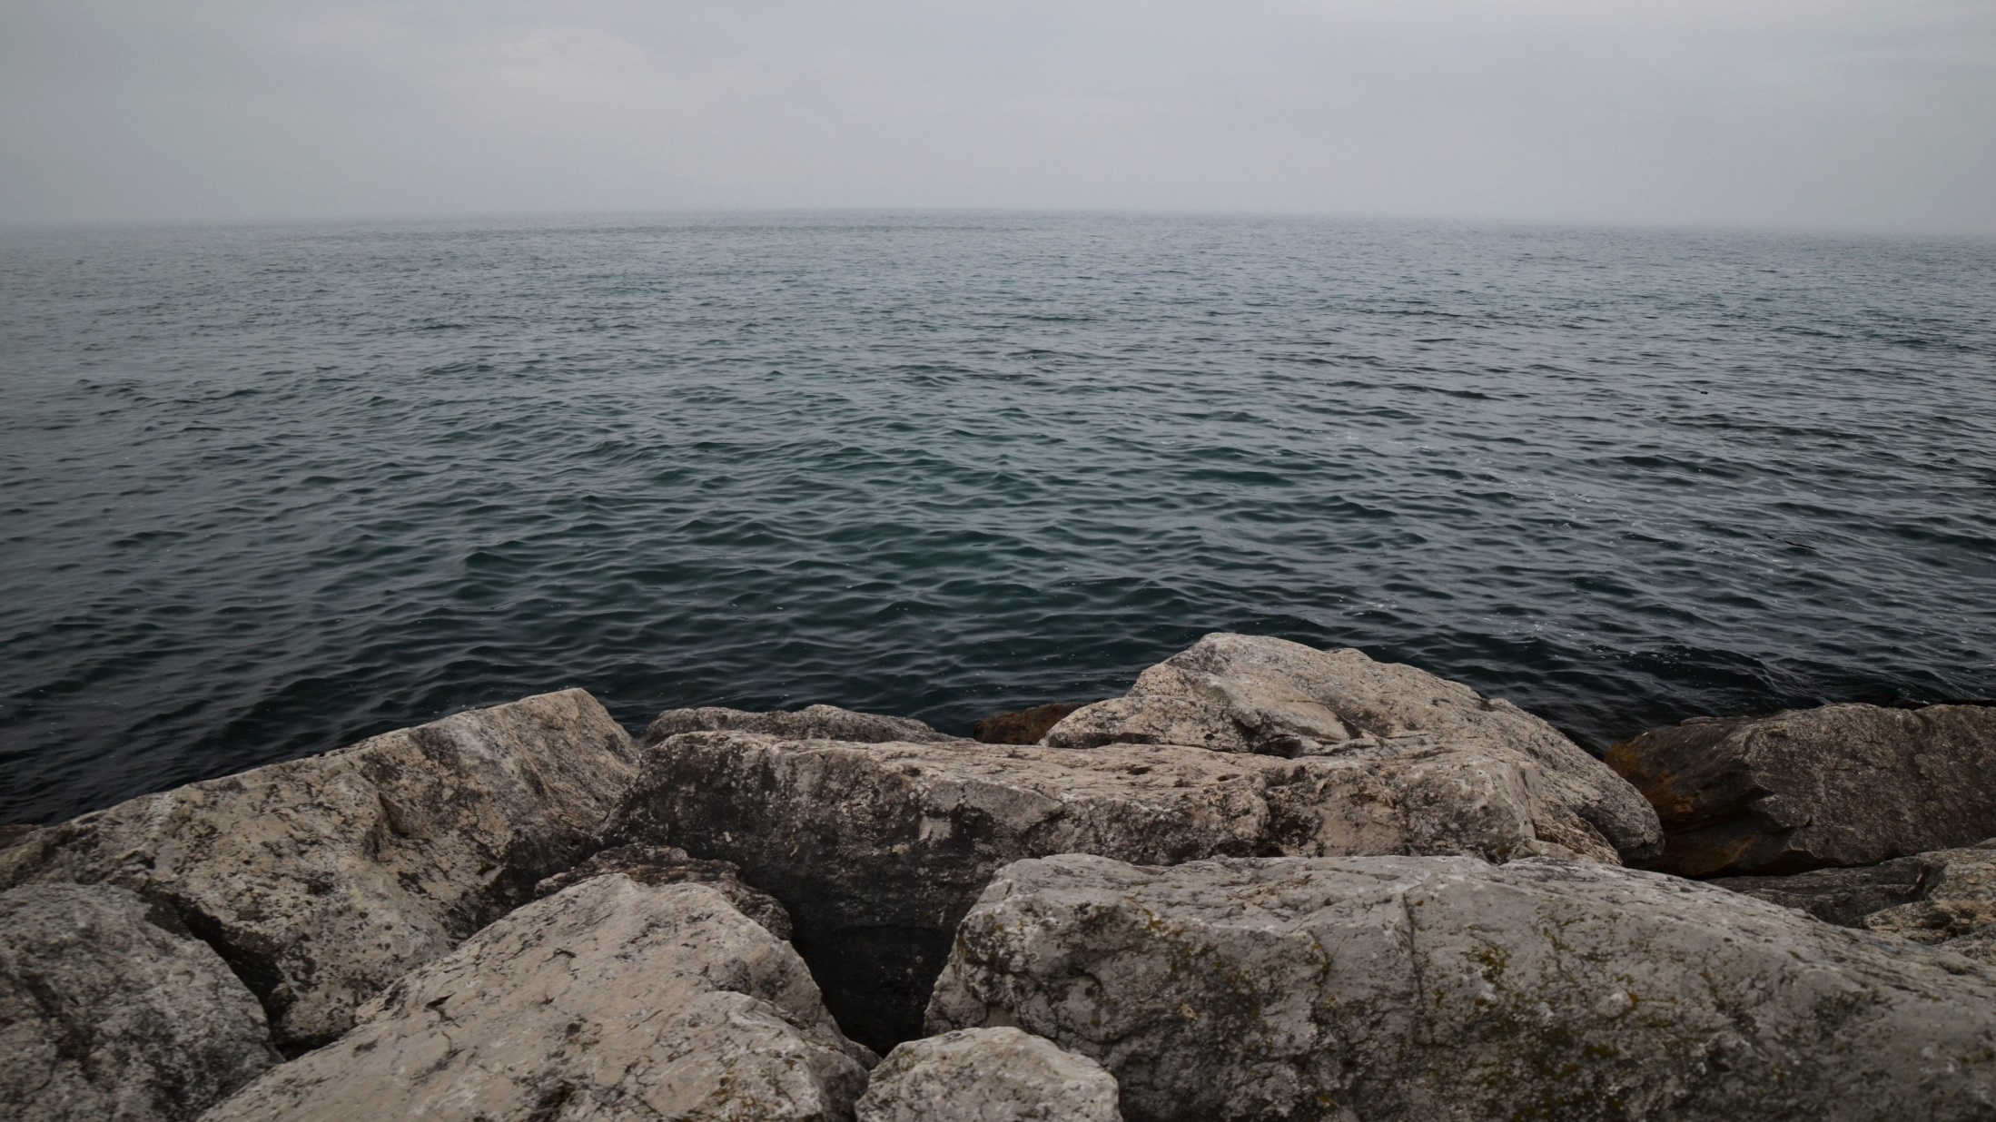
13th ANNUAL
Clean Rivers, Clean Lake Conference
Session 6:
Regulation and Policy: Getting Green Infrastructure Right

Slide 2
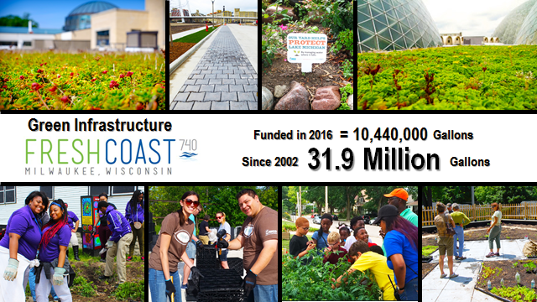

Slide 3
MMSD Green Infrastructure Center of Excellence

Slide 4
Business Model Canvas

Slide 5
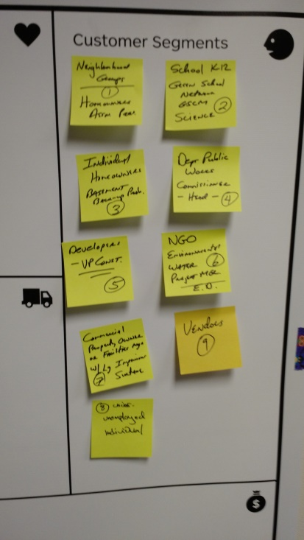
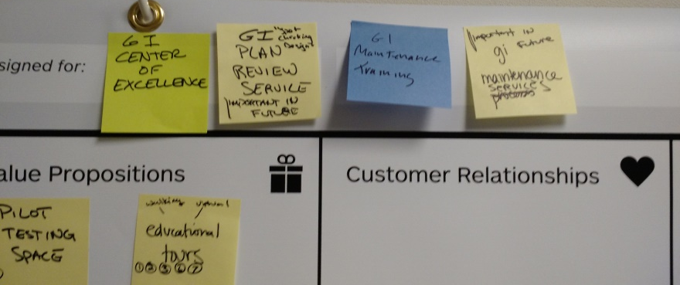
MMSD Green Infrastructure Center of Excellence

Slide 6
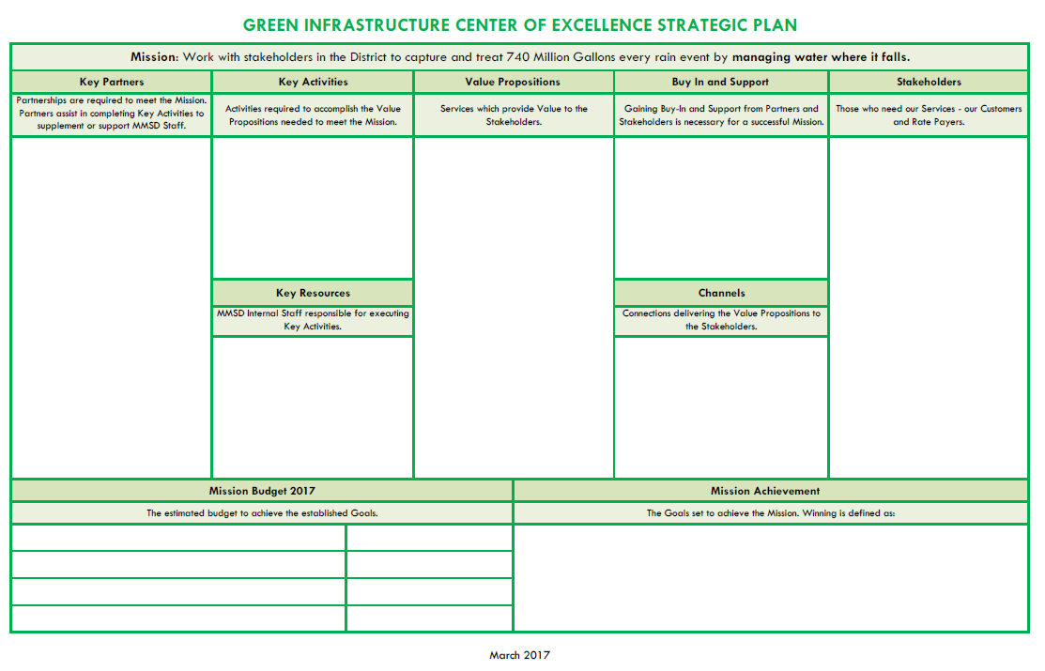

Slide 8
Value Propositions (Services)
Grant Funding
Grant Writing Services
GI Design Services
Plans/Specs/Standards
GI Workshops
DIY Demos
Workforce Development
Certification/Training Services
GI Educational Tours
Pilot Testing Site and/or
Pilot Testing Relationship Building

Slide 9
Mission Achievement
(Define Winning)
10 MG of New GI Added in Year 1 (2017-2018)
10 New Individuals Trained and Certified through the Training/Certification Program
Achieve a 50% Hit (Success) Rate on Grant Applications Awarded
Serve 1,000 New Stakeholders in Year 1 (2017-2018)

Slide 10
GI Center of Excellence Office
Located in Suite 440 of Global Water Center (this building)
Open for walk-ins or by appointment
8-5 Mon-Thurs, 8-12 Friday
Future location to be determined

Slide 11
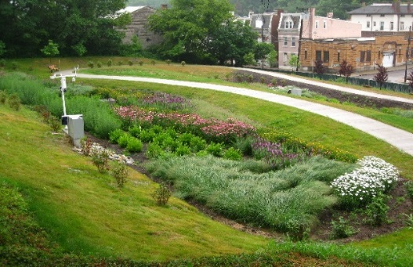
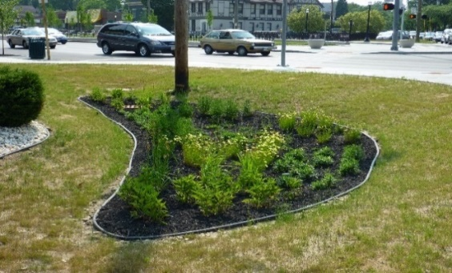
Green Infrastructure Standard
Specifications and Plan Templates
Clean Rivers Clean Lakes Conference
May 4, 2017

Slide 12
Outline
Project Goals and Objectives
Green Infrastructure Sizing Calculator
Standard Plan Templates / Typical Details
Standard Specifications
Plan Template Report

Slide 13
Project Goals and Objectives
The District has adopted its 2035 Vision that includes multiple objectives of zero basement backups, zero overflows, reduced water quantity and improved water quality consistent with the Regional GI Plan.
The District intends to utilize GI strategies to capture and manage the first 0.5 inches of rainfall that falls on impervious cover, with a long-term goal of providing approximately 740 million gallons of storage volume through the GI strategies.

Slide 14
Project Goals and Objectives
Provide various GI specifications and plan templates for project partners moving forward on GI projects.
Opportunity to maximize future funding opportunities, save money on design, and help ensure projects function as designed.
Standard specifications and plan templates to help future projects avoid failing and being “overdesigned.”
Simplify and standardize the design process for various types of GI that can assist both public and private entities in the process of developing and implementing GI projects.

Slide 15
Project Goals and Objectives
The GI Standard Specifications and Plan Templates project is focused on the following GI strategies:
Bioretention / Bioswale
Porous Pavement
Rain Garden
Stormwater Trees
Native Landscaping
Soil Amendments

Slide 16
Project Goals and Objectives
Tools developed include the following:
Green Infrastructure Sizing Calculator
Standard Plan Templates / Typical Details
Standard Specifications
GI Standard Specifications and Plan Templates Report

Slide 17
GI Sizing Calculator
Calculator Includes the following strategies:
Bioswale / Bioretention
Porous Pavement
Rain Garden
Stormwater Trees
Native Landscaping
Soil Amendments

Slide 18
GI Sizing Calculator
(Bioswale/Bioretention)

Slide 19
GI Sizing Calculator (Porous Pavement)

Slide 20
GI Sizing Calculator (Rain Garden)

Slide 21
GI Sizing Calculator (Stormwater Tree)

Slide 22
GI Sizing Calculator (Native Landscaping)

Slide 23
GI Sizing Calculator (Soil Amendments)

Slide 24
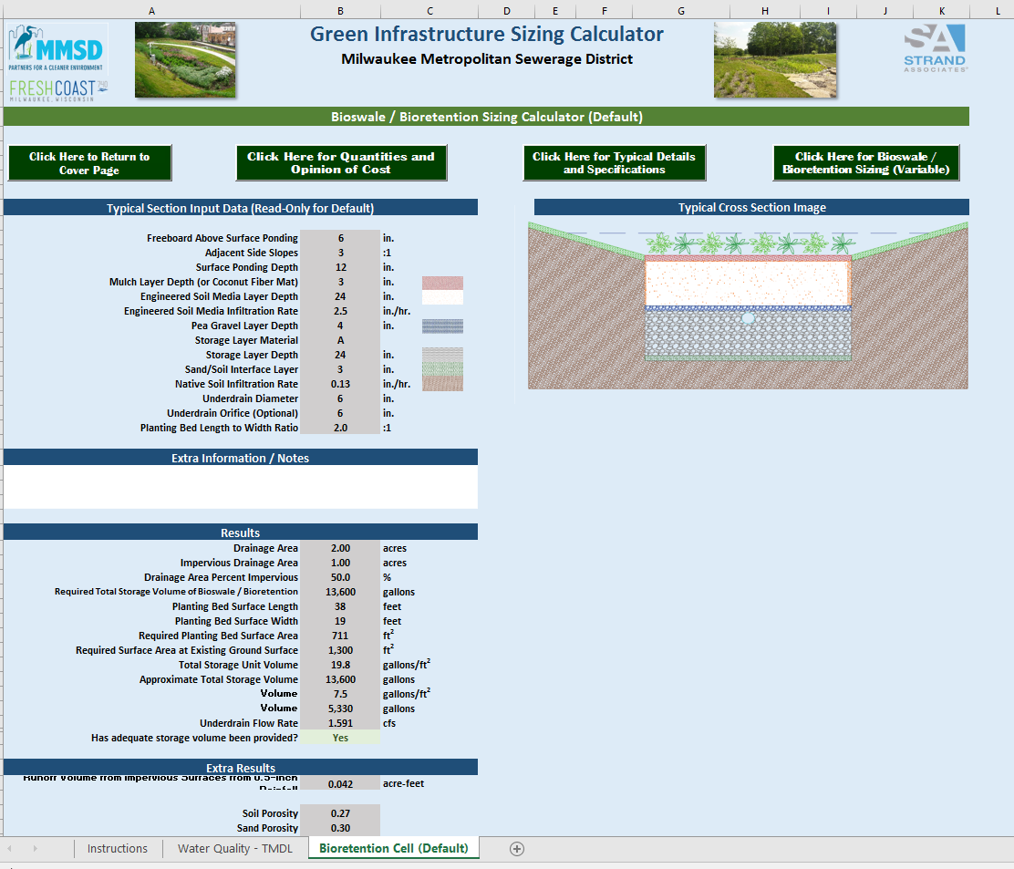
GI Sizing Calculator (TMDL)

Slide 25
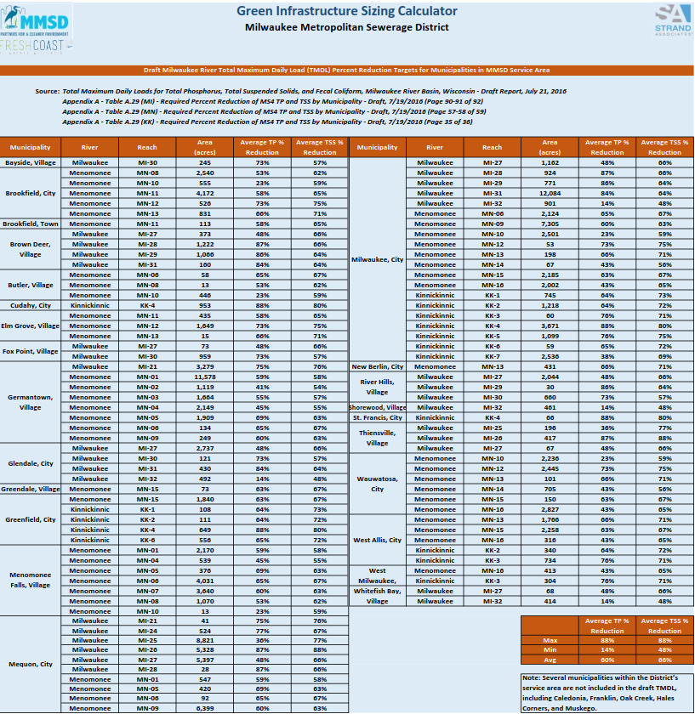
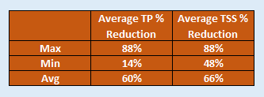
GI Sizing Calculator

Slide 26
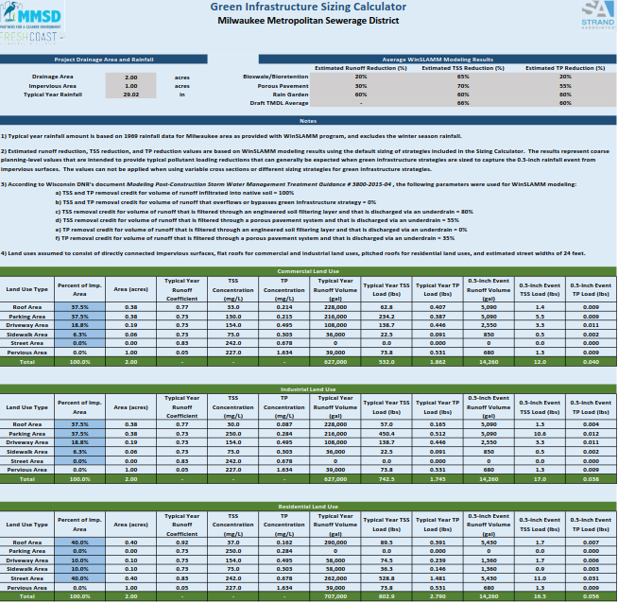
GI Sizing Calculator

Slide 27
WinSLAMM Modeling
GI Strategies Evaluated

Slide 28
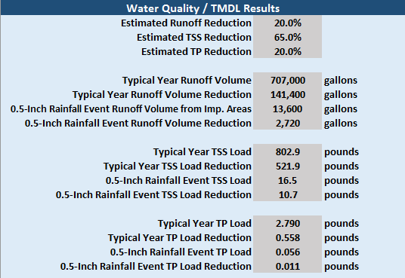
GI Calculator TMDL Results

Slide 29
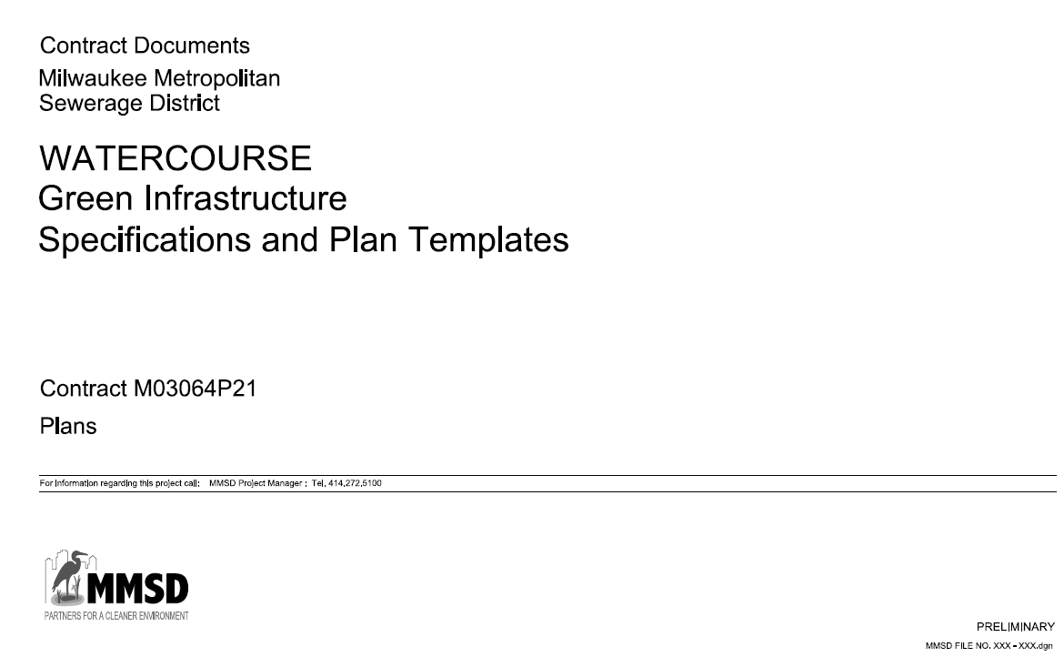
GI Standard Plan Templates
Standard Plan Templates / Typical Details Developed
Bioretention/Bioswale
Porous Pavement
Rain Garden
Standard Plan Templates / Typical Details in Progress
Stormwater Trees
Native Landscaping
Soil Amendments

Slide 30
Plan Templates – Bioretention/Bioswale
Plan and Section Views – Open Space with Side Slopes (grass)
Plan and Section Views – Concrete Perimeter (curb)
Details
Overflow
Cleanout
Observation Well
Anti-Seep Collar
Plant Spacing
Cross Section – Trench Drain and Splash Pads
Plan and Section Views – Pretreatment Basin Option
Plan and Section Views – Filter Strip Option

Slide 31
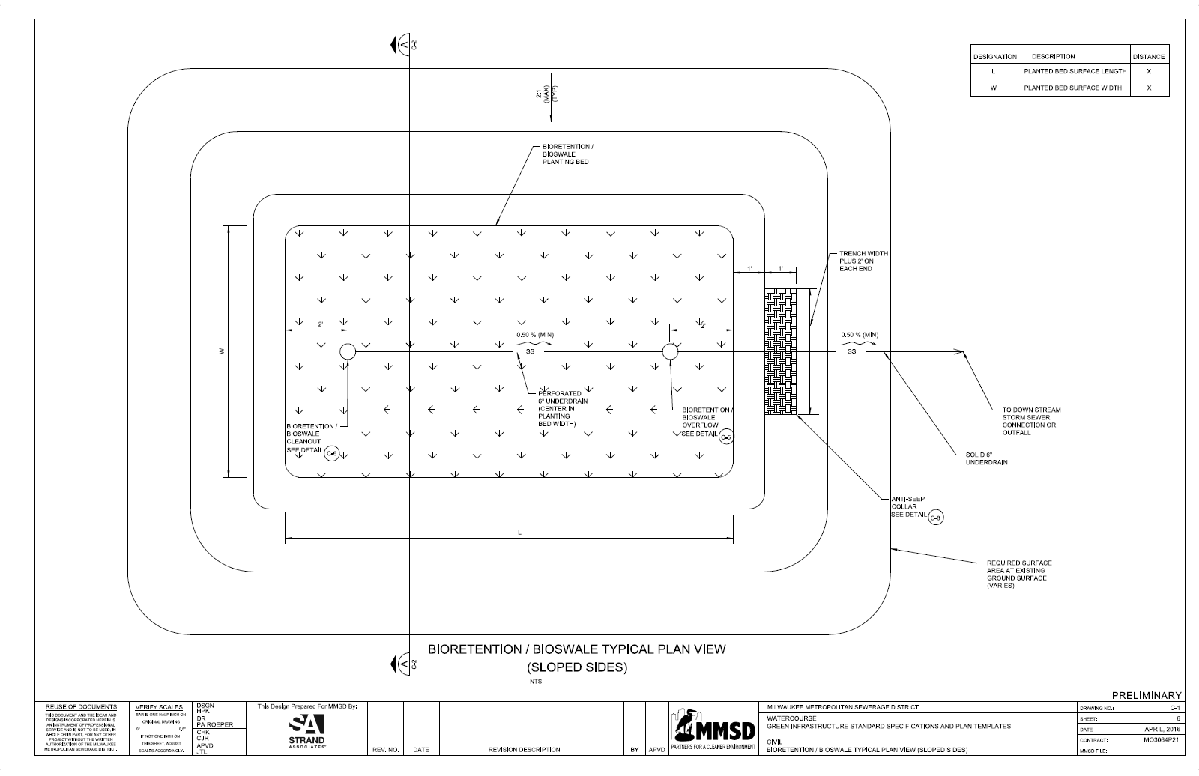
Plan Templates – Bioretention/Bioswale Typical Plan View (Sloped Sides)

Slide 32
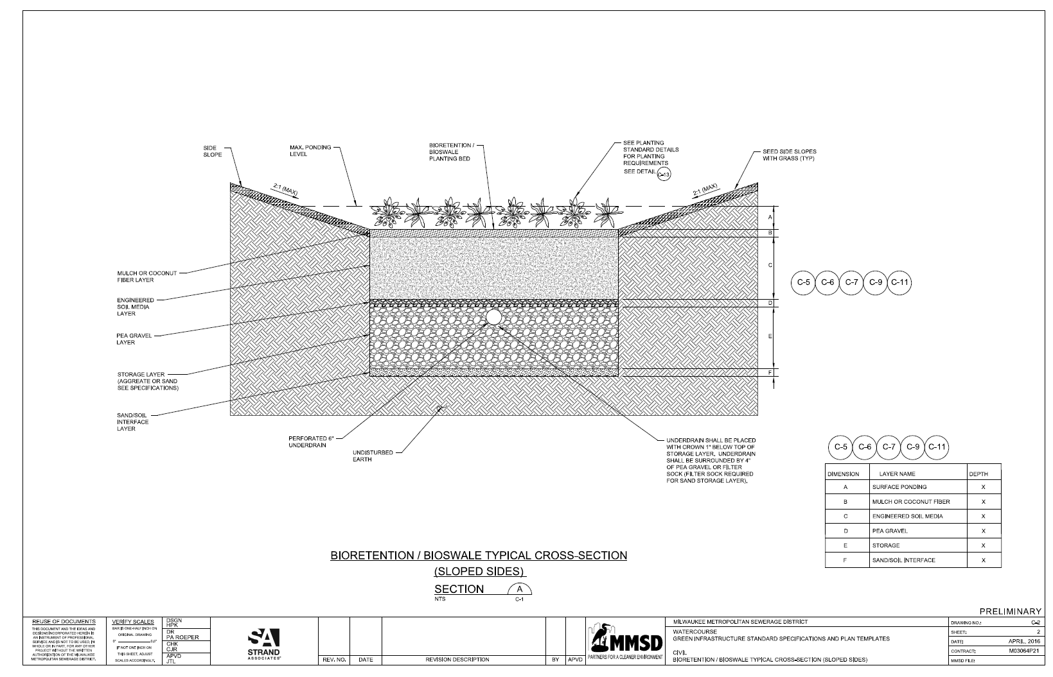
Plan Templates – Bioretention/Bioswale Typical Cross Section (Sloped Sides)

Slide 33
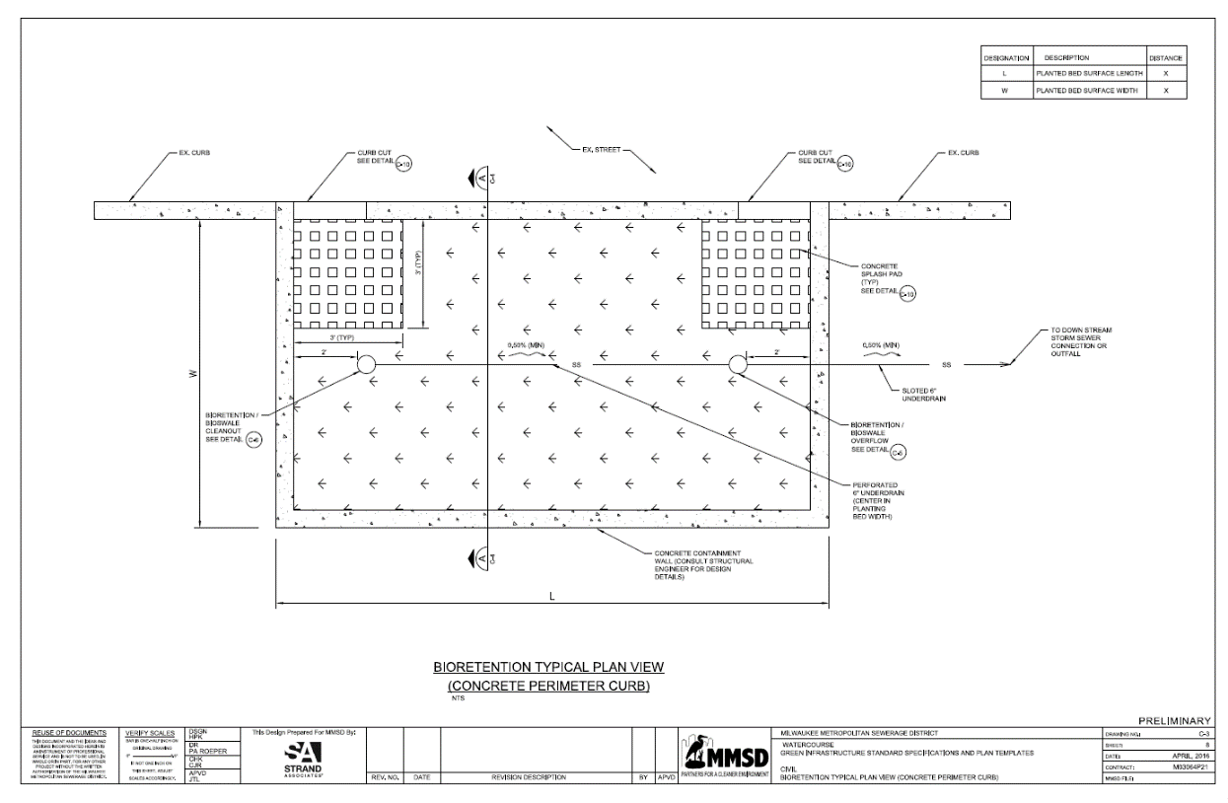
Plan Templates – Bioretention/Bioswale Typical Plan View (Concrete Perimeter Curb)

Slide 34
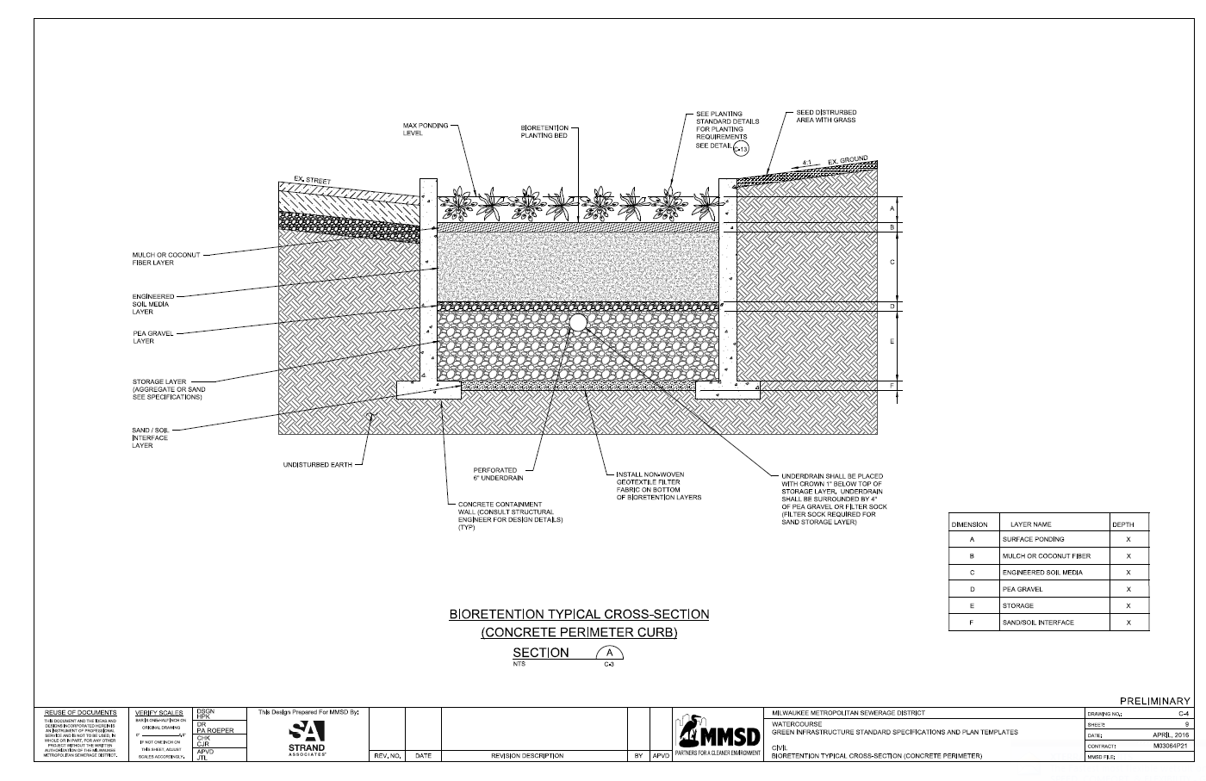
Plan Templates – Bioretention/Bioswale Typical Cross Section (Concrete Perimeter Curb)

Slide 35
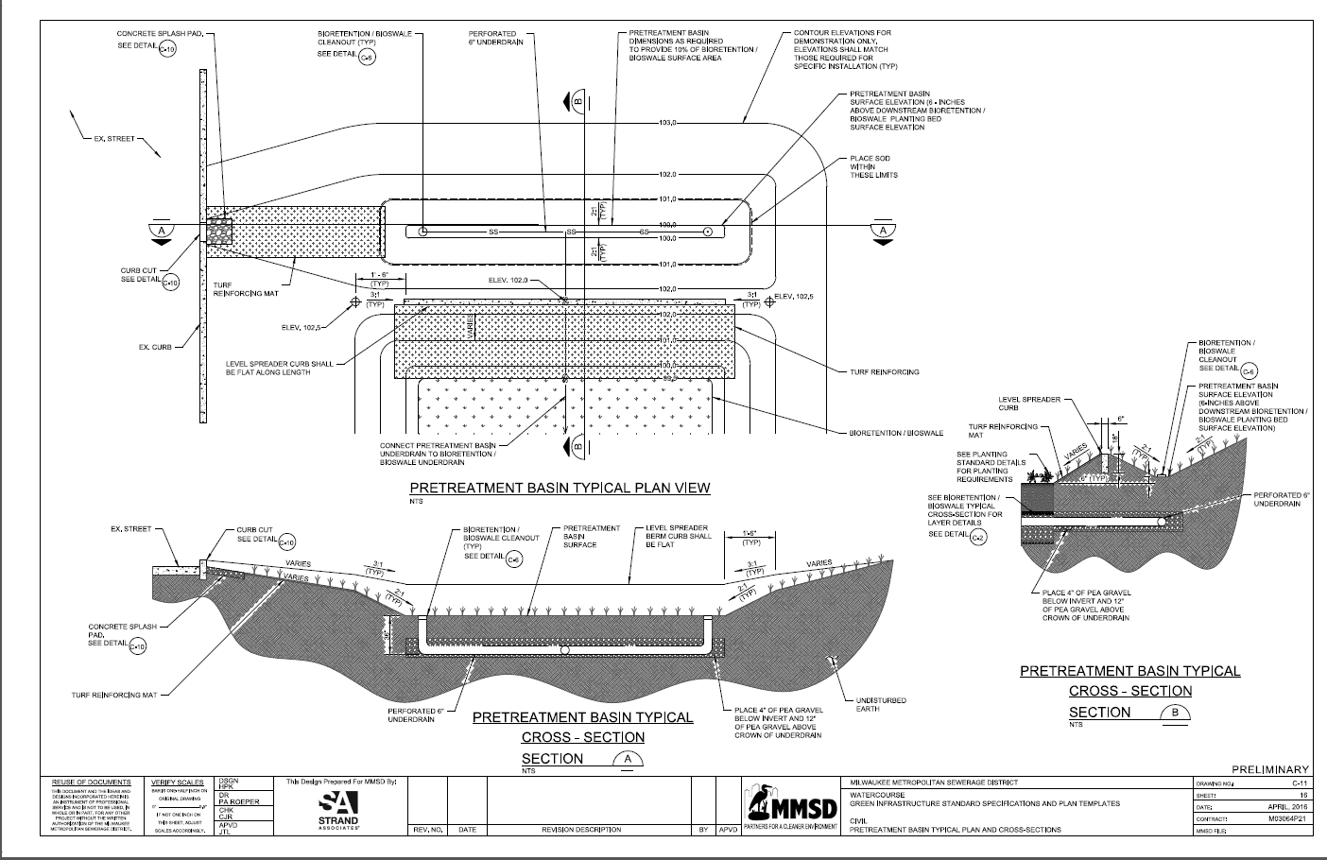
Plan Templates – Bioretention/Bioswale Pre-Treatment Option

Slide 36
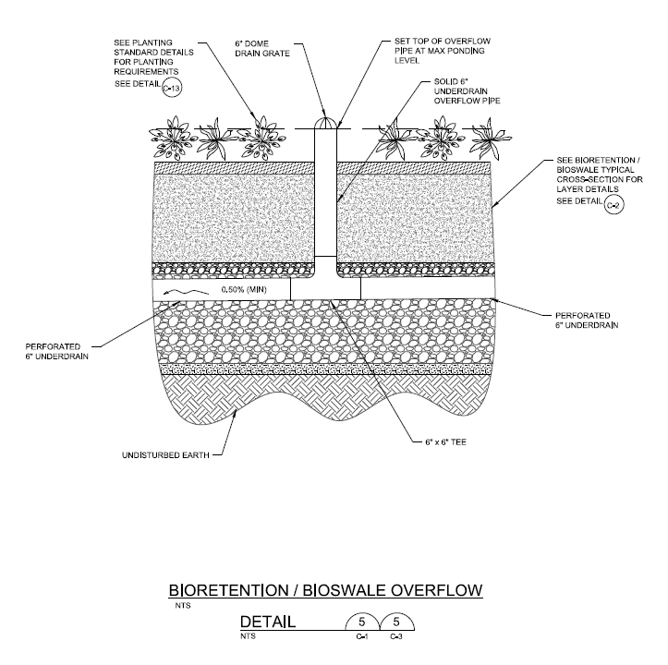
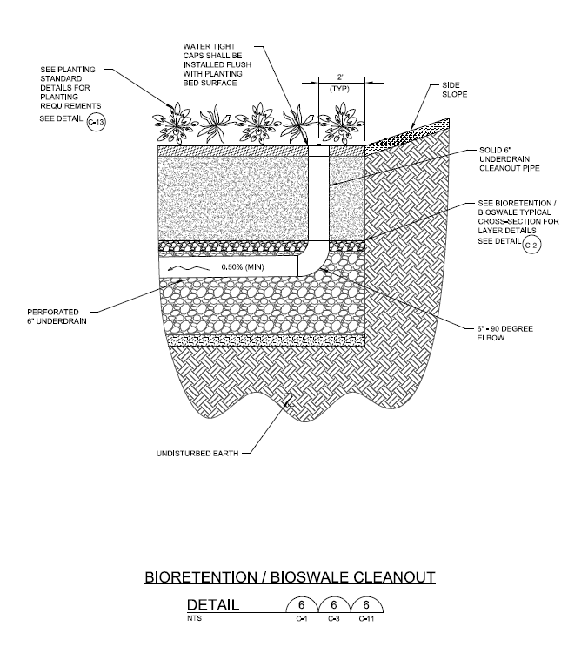
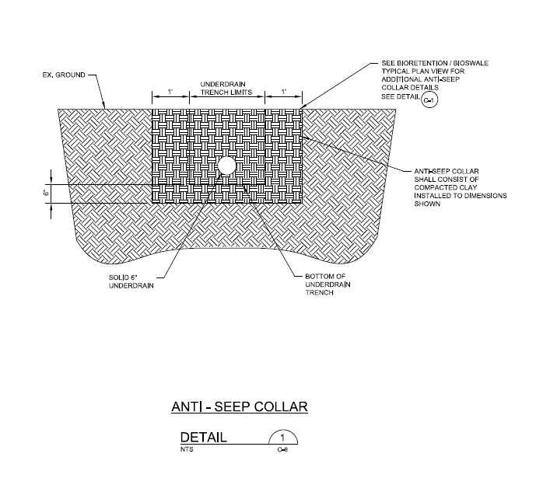
Plan Templates – Bioretention/Bioswale
Overflow Structure
Cleanout Detail
Anti-Seep Collar

Slide 37
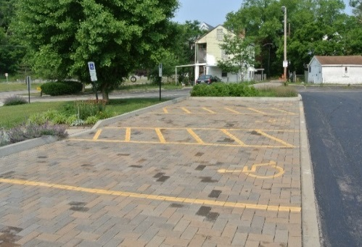
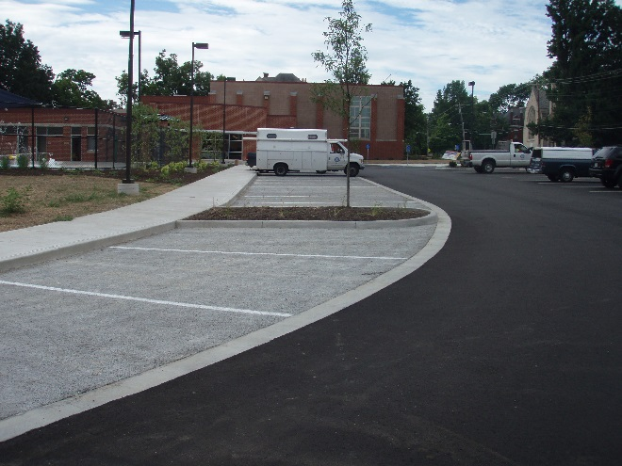
Plan Templates – Porous Pavement
Plan and Section Views – Permeable Pavers
Plan and Section Views – Pervious Concrete/Porous Asphalt
Details
Cleanout
Observation Well

Slide 38
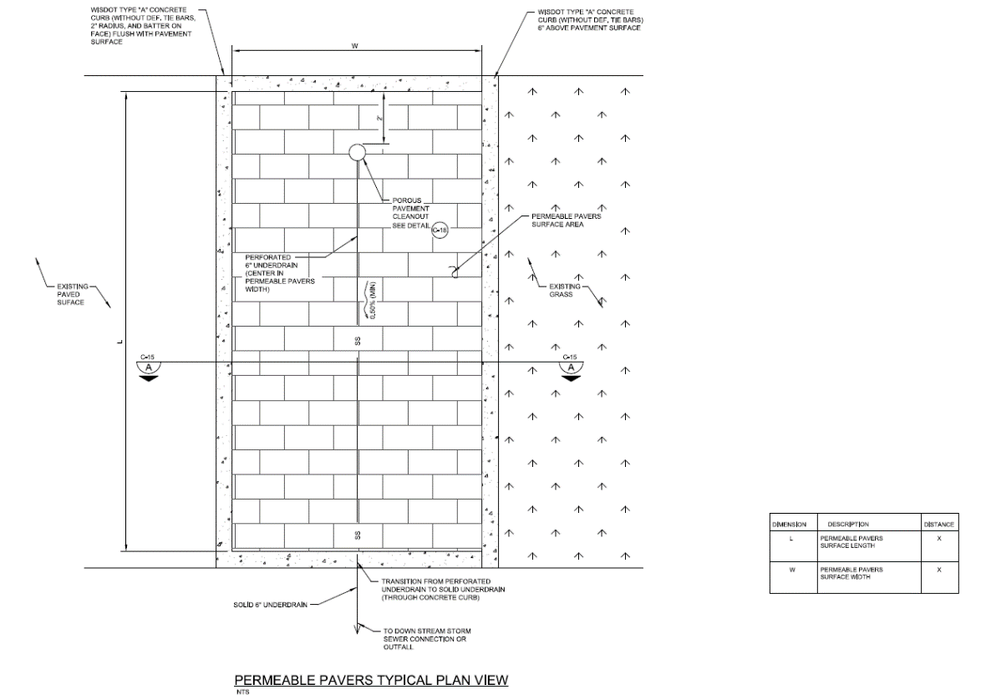
Porous Pavement – Permeable Pavers

Slide 39
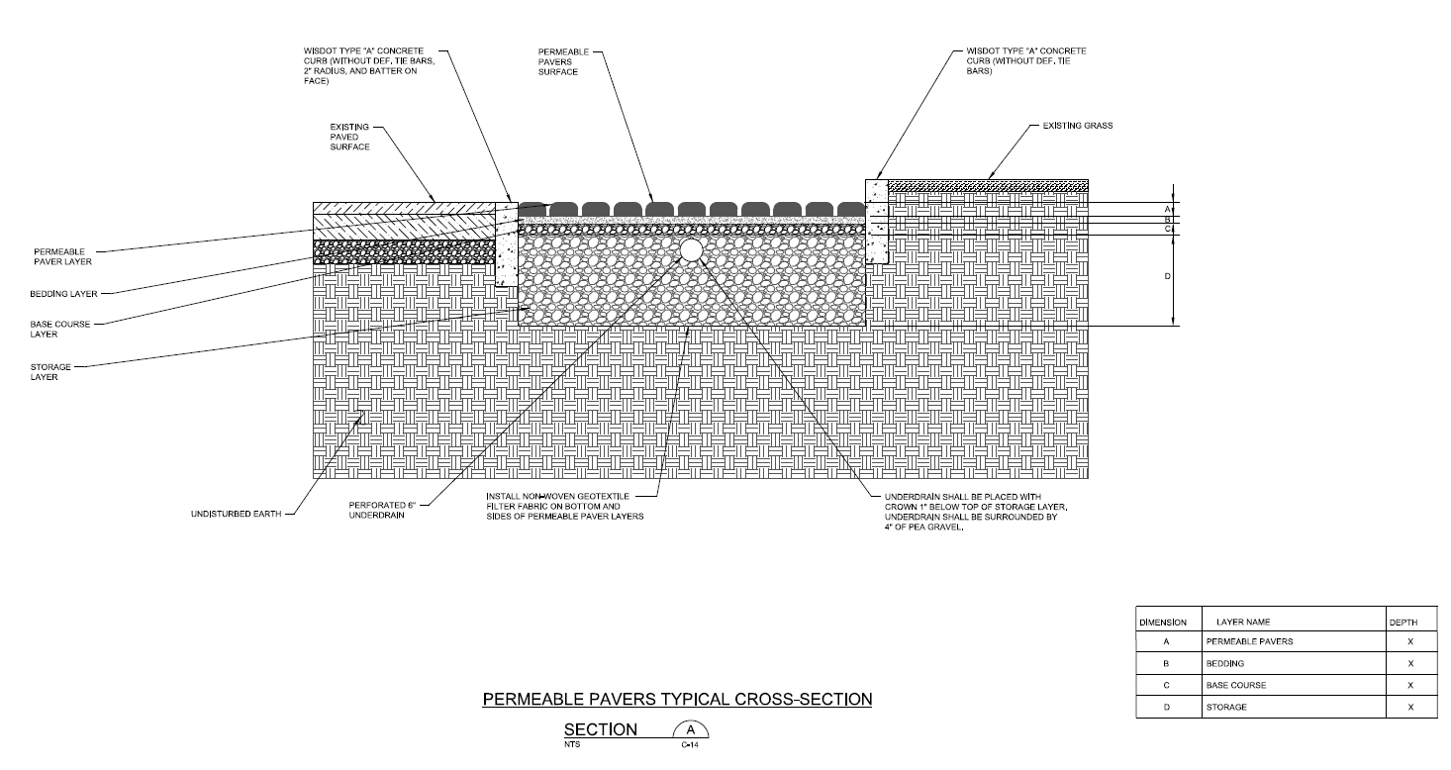
Porous Pavement – Permeable Pavers

Slide 40
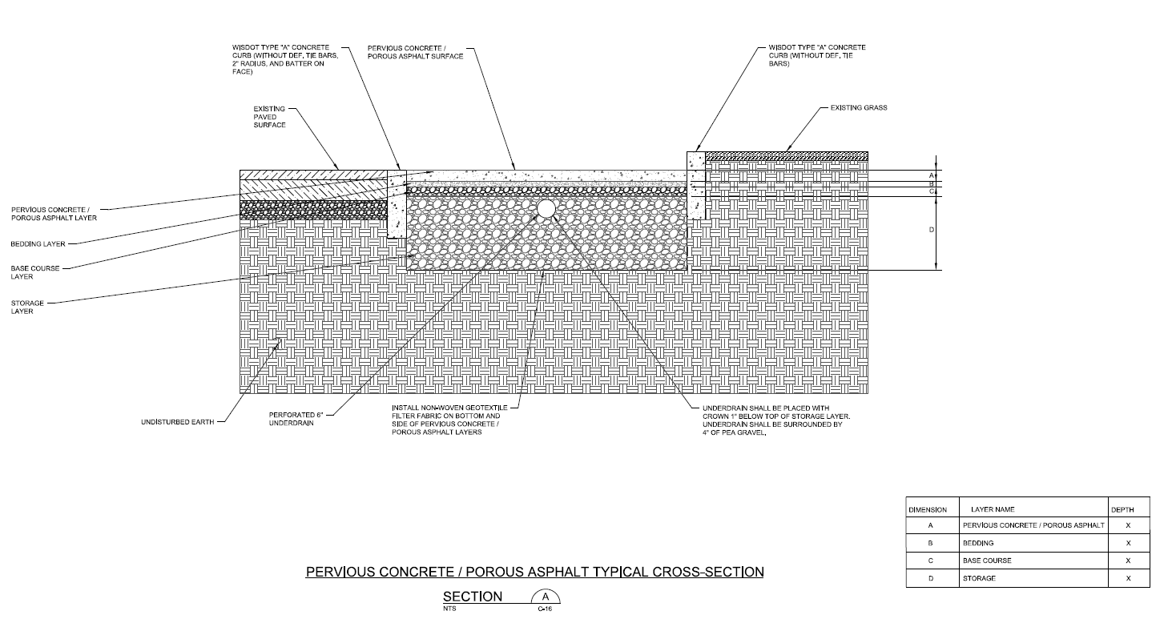
Porous Pavement – Concrete/Asphalt

Slide 41
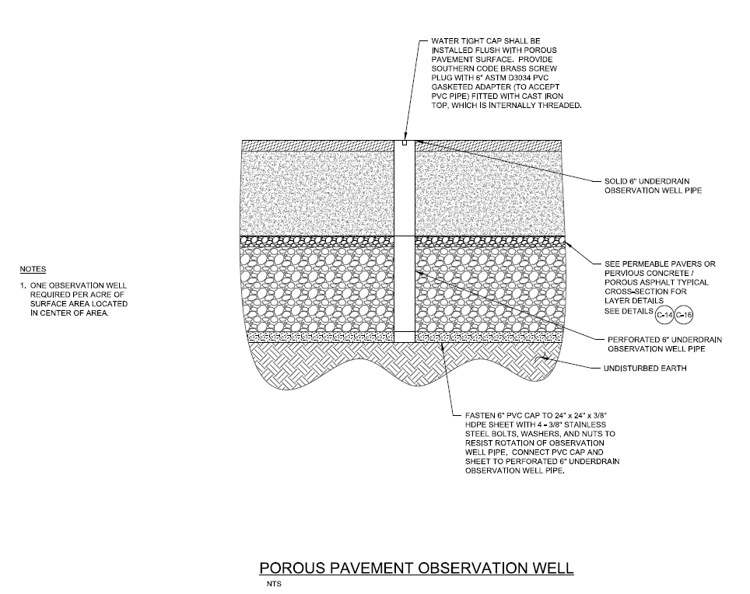
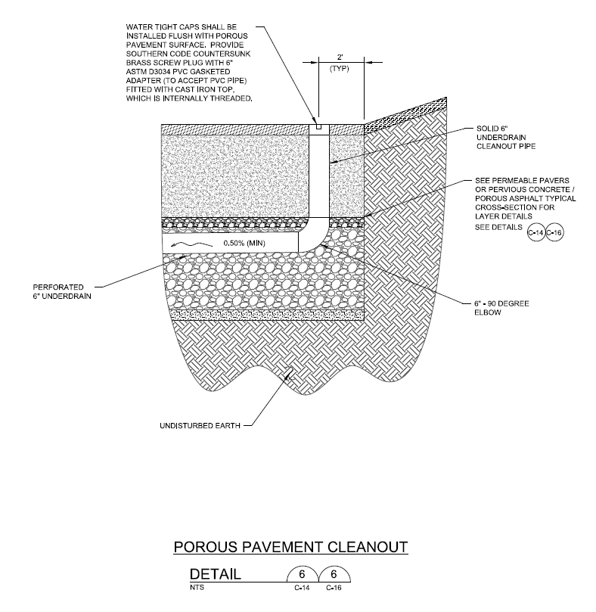
Porous Pavement – Details
Cleanout Detail
Observation Well Detail

Slide 42
Plan Templates – Rain Garden
Plan and Section Views – Rain Garden
Detail – Energy Dissipation Stone
Detail – Plant Spacing

Slide 43
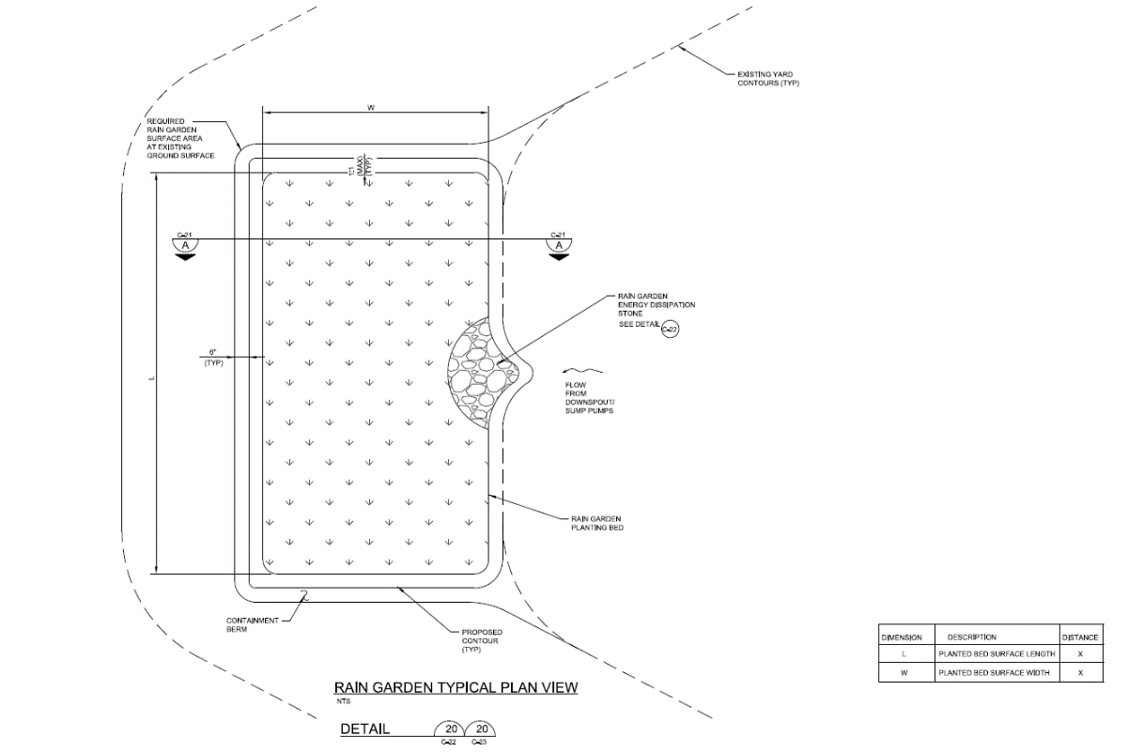
Rain Garden – Plan View

Slide 44
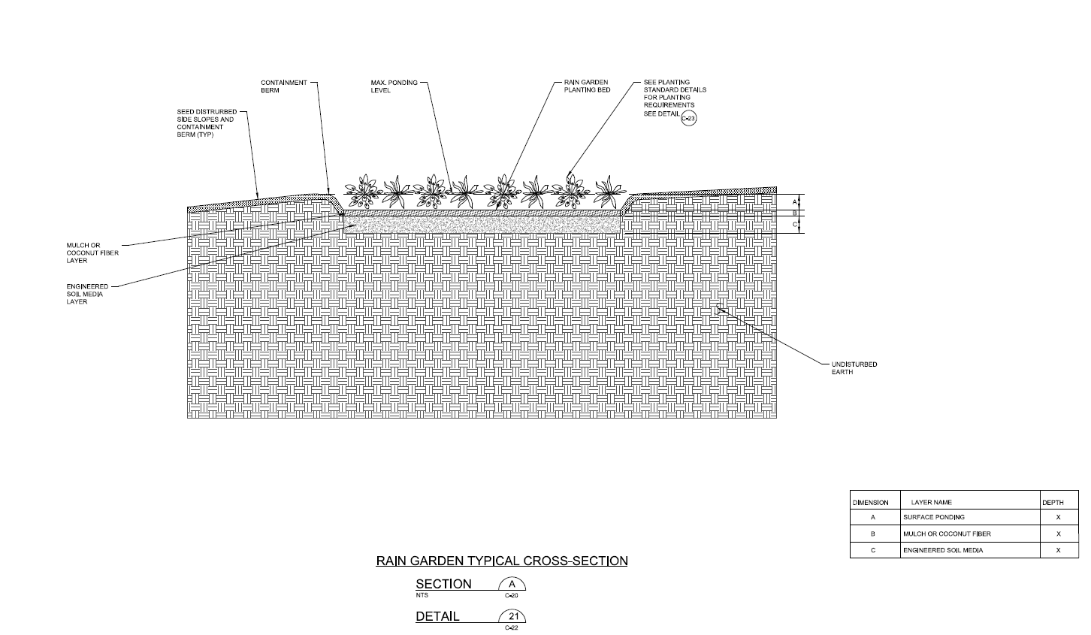
Rain Garden – Cross Section

Slide 45
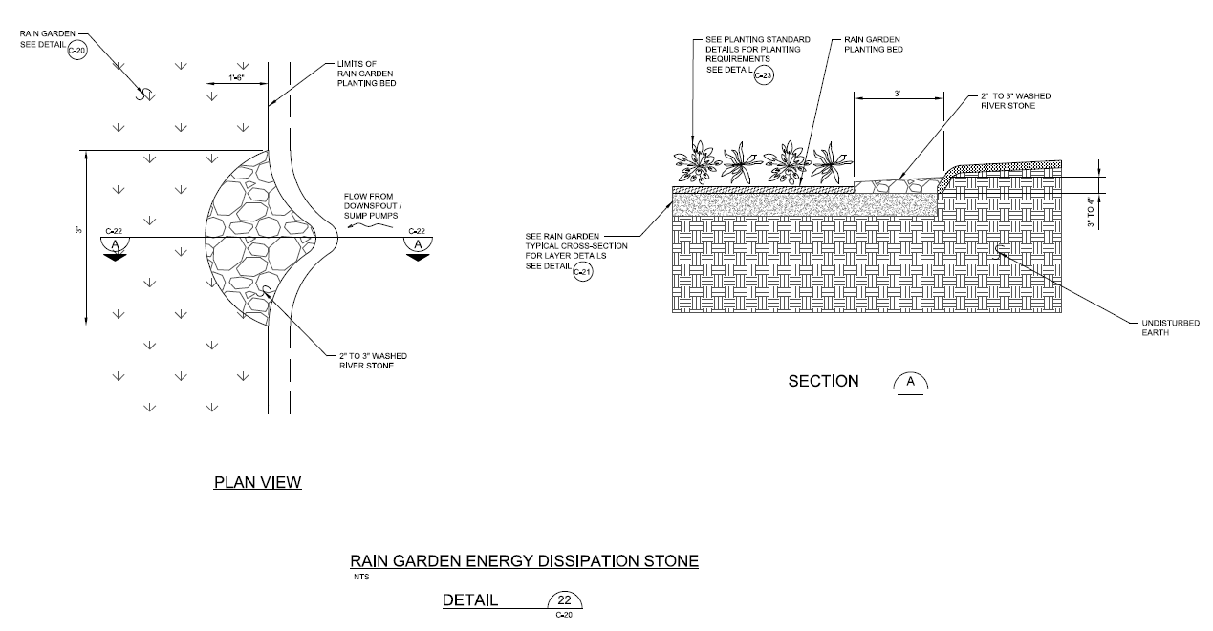
Rain Garden – Details

Slide 46
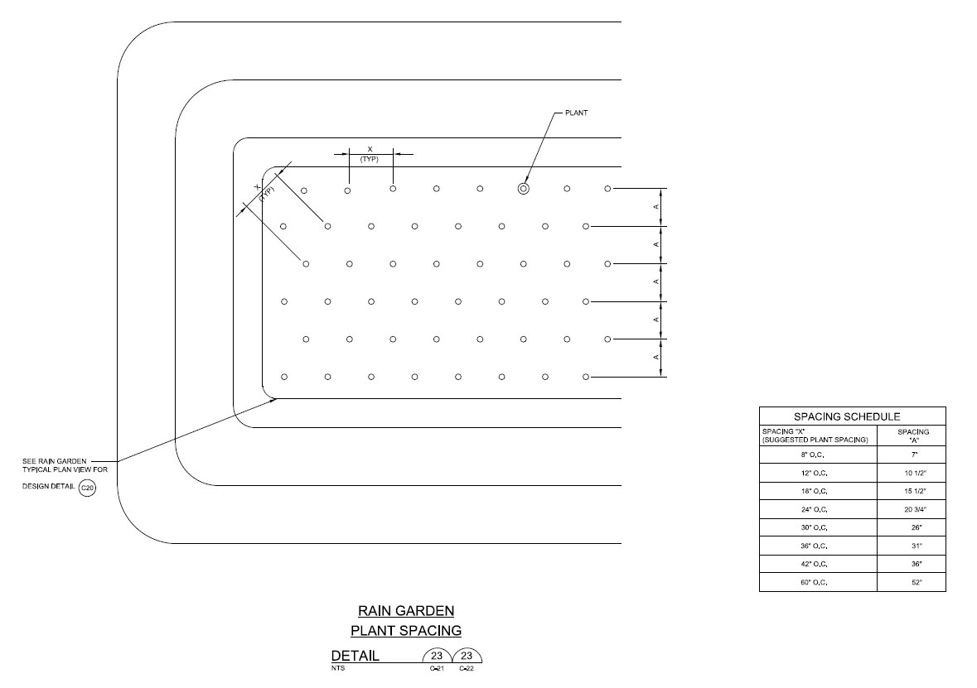
Rain Garden – Plant Spacing

Slide 47
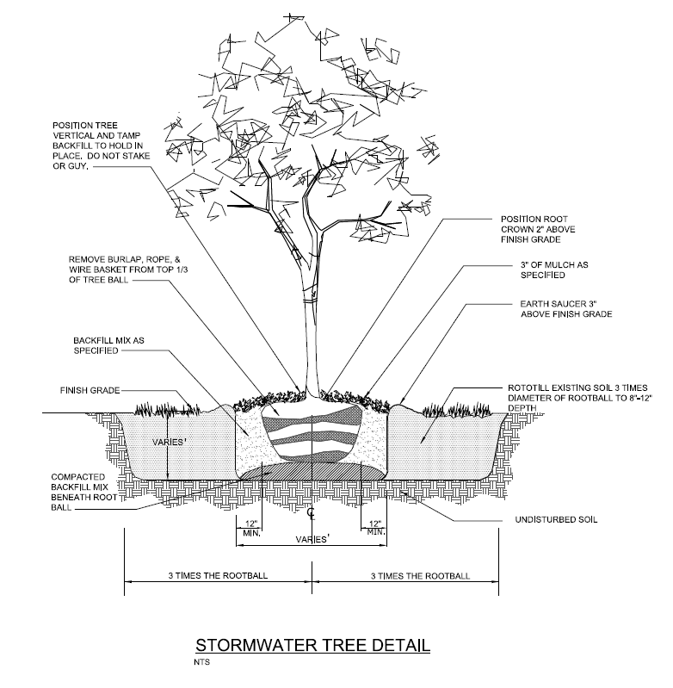
Plan Templates – Stormwater Trees

Slide 48
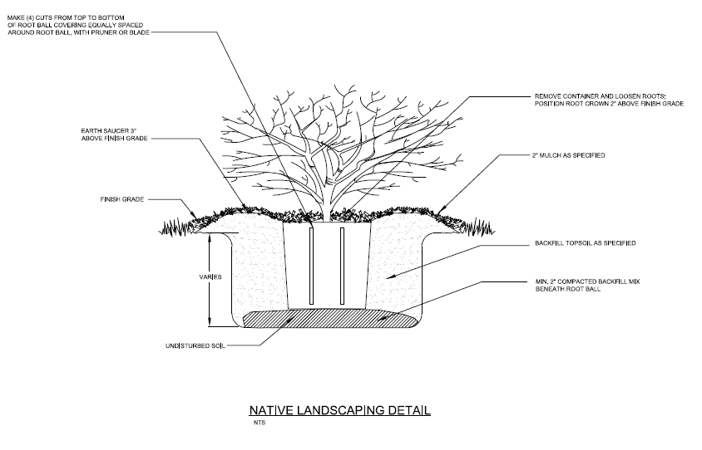
Plan Templates – Native Landscaping

Slide 49
GI Standard Specifications
Standard Specification Section
Bioretention/Bioswale
Porous Pavement
Rain Garden
Stormwater Trees
Native Landscaping
Soil Amendments

Slide 50
Specification Format
Follows MMSD format (three part)
Part A – Scope (Related work, submittals, qualifications, etc.)
Part B – Materials (Media, surface layer, storage layer, piping, etc.)
Part C – Workmanship (Site stabilization, suitable weather, compaction avoidance, etc.)
Specifications are based on WDNR Technical Standards where applicable

Slide 51
GI Standard Specifications and Plan Templates Report
Concise report to supplement GI calculator, specifications and plan templates.
Report Contents
Introduction (Purpose, GI tool, summary of strategies)
GI Strategies (Individual Sections)
Bioretention/Bioswales
Rain Gardens
Porous Pavement
Stormwater Trees
Native Landscaping
Soil Amendments
TMDL Considerations
Appendix A – Plan Templates/Example Typical Details
Appendix B – Specifications
Appendix C – Inspection and Maintenance Checklists
Appendix D – Trees and Plant Lists

Slide 52
Presentation Summary
GI Sizing Calculator – Planning Level tool to Evaluate Preliminary Costs and Sizing Requirements for GI
GI Standard Plan Templates - Provides General Cross Section for GI Strategies
GI Standard Specifications – Provides Material Specifications and Installation Requirements for GI
GI Template Report – Provides Additional Information to Supplement GI Calculator

Slide 53
Where the tool can be found
http://www.freshcoast740.com/size-it
Download the zip file to have access to the GI Plans, Specs, and sizing tool

Slide 54
Thank You! Questions?
Andy Kaminski
MMSD
Voice: (414) 225-2245
akaminski@mmsd.com
Philip A. Bzdusek, Ph.D., P.E.
Strand Associates, Inc.
Voice: (414) 982-2300 Ext. 1505
Phil.bzdusek@strand.com

Slide 55
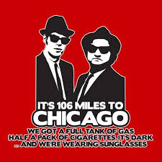
It’s 106 miles to Chicago, we got a full panel, half an hour before the reception, it’s a dark room and there’s another power point about barriers to green infrastructure.

Slide 56
Codes & Ordinances Initiative has been sticking around since 2012:
Identified active (written) and “passive” (unwritten or staff) barriers to use of green infrastructure in new development, redevelopment and municipal projects throughout the MMSD service area
Providing staff support for code, plan and policy revisions for GI
Many have updated or are updating different codes & standards – including our panelists today

Slide 57
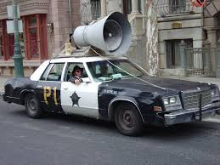
Crucial barriers identified and described in the last four conference presentations, with different movie / sports themes
Metro Milwaukee Codes are OLD:
Wauwatosa’s brilliant description – the “Exploding Pinto” from 1973
Actual conditional use in XXXXxxxxx’s code: “Homes for the feeble-minded”
Some have very prescriptive landscaping standards from the 1990s – active problem for using bioretention, trees, natives
Staff interpretation, board preferences more important than actual regulations & standards
Plans are often far more up to date and progressive than the regulations and standards
Communities that have updated zoning, DPW standards see more contemporary practices implemented – including GI
What signal is being sent to the community, applicants about water quality, preferred landscaping approaches, etc?

Slide 58
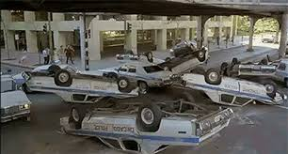
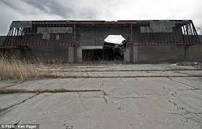
What Changes Are Mission-Critical?
Eliminating direct, code-based prohibitions on use of permeable surfacing
Updated parking standards including shared parking – reducing runoff volumes, making GI more feasible (also business-friendly)
Landscaping standards, especially for parking lots, that actively encourage integration with GI; native lawns too
Reduced or flexible lot frontage, setbacks – reduce the amount of roadway, curbing, and turfgrass, especially in suburbus with new subdivision
Definitions of GI practices included in zoning and the stormwater ordinance
Standards & review for water quality impacts – especially trash, food-related, animal-related uses (hello, Bacteria TMDL!)
Shared Parking
Permeable surfacing/native lawn

Slide 59
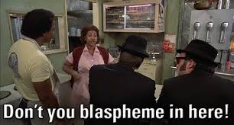
CHANGE RESISTANCE: Staff, attorneys, elected/appointed officials usually are not enthusiastic about changing codes:
#1 The Matt “Guitar” Murphy Reaction:
Don’t go changin’!
#2 The “Blasphemy!” Reaction:
#3 The Penguin Reaction:
We do not want your filthy green [infrastructure]
#4 The wow-I-don’t-even-know-where-to-start Reaction:

Slide 60
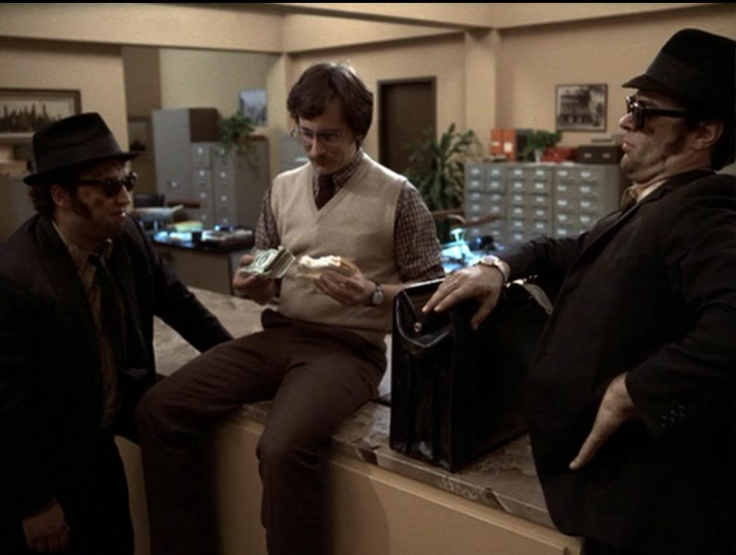
10 communities have made, or are working on, code changes – How do we get to the finish line?
Presentations to municipal boards & commissions
Lunch ‘n learn – peer to peer exchange about success stories, legal issues
Strategic/piecemeal updates
RFP development for larger “overhauls”
Working with consulting engineers on stormwater standards
Identifying & gaining funding for pilot projects
Hearing from your colleagues

Slide 61
Panelists today: Discussing our follow-on work to implement recommendations – and get pilot projects or policies underway
Melinda Dejewski, PE, City of St Francis
Gabe Gilbertson, City of Menomonee Falls

Slide 62
Village of Menomonee Falls Trash Enclosure Ordinance
Gabriel Gilbertson
Planner
Clean Rivers, Clean Lake:
Village of Menomonee Falls Trash Enclosures
May 4, 2017

Slide 63
Trash Enclosure Ordinance Overview
Adopted March 6, 2000 by the Village Board with a recommendation from the Protection of Persons and Property Committee
Declared unscreened waste containers to be a public nuisance
Staff created database of non-compliant industrial and commercial businesses
Clean Rivers, Clean Lake:
Village of Menomonee Falls Trash Enclosures
May 4, 2017

Slide 64
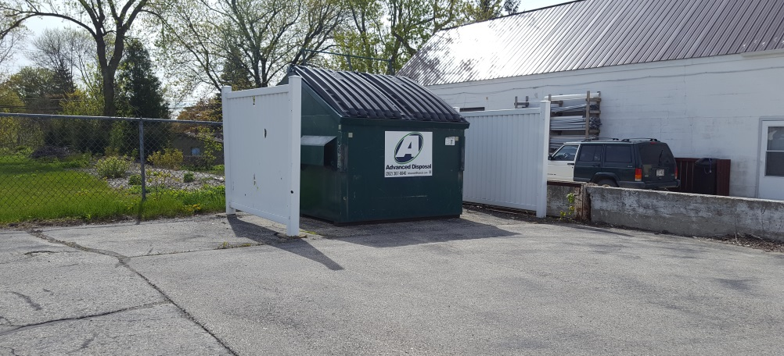
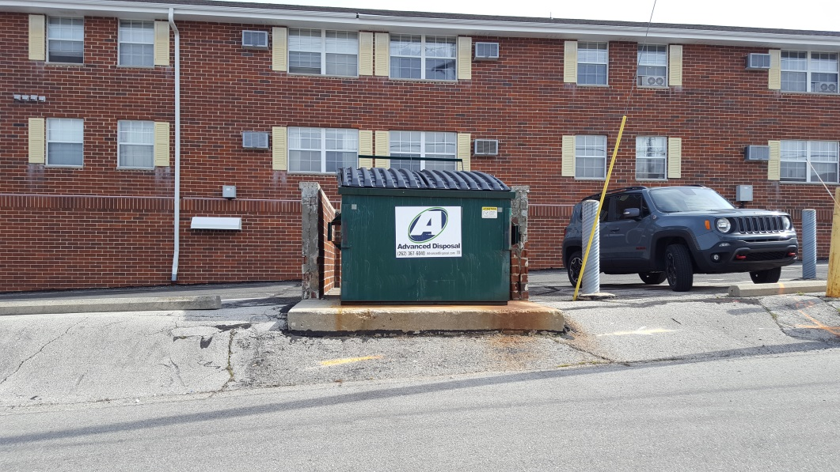
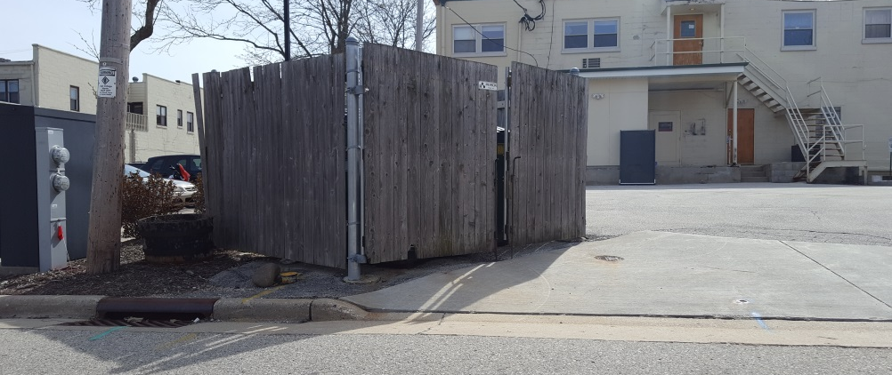
Trash Enclosure Ordinance Overview
Gave business owners one year to comply
Original Ordinance required all enclosures to be approved by the Architectural Control Board and all fees waived.
ACB approval later removed from Ordinance
Clean Rivers, Clean Lake:
Village of Menomonee Falls Trash Enclosures
May 4, 2017

Slide 65
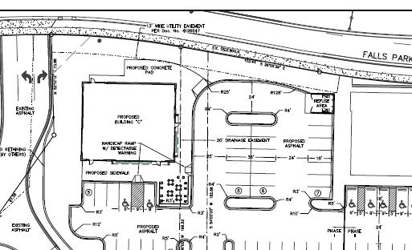
Trash Enclosure Ordinance Overview
Required dumpster enclosures to:
Be incorporated into overall design of building
Located away from street and concealed from building entrances
Materials, colors, and design conform to predominant colors and materials of building
Clean Rivers, Clean Lake:
Village of Menomonee Falls Trash Enclosures
May 4, 2017

Slide 66
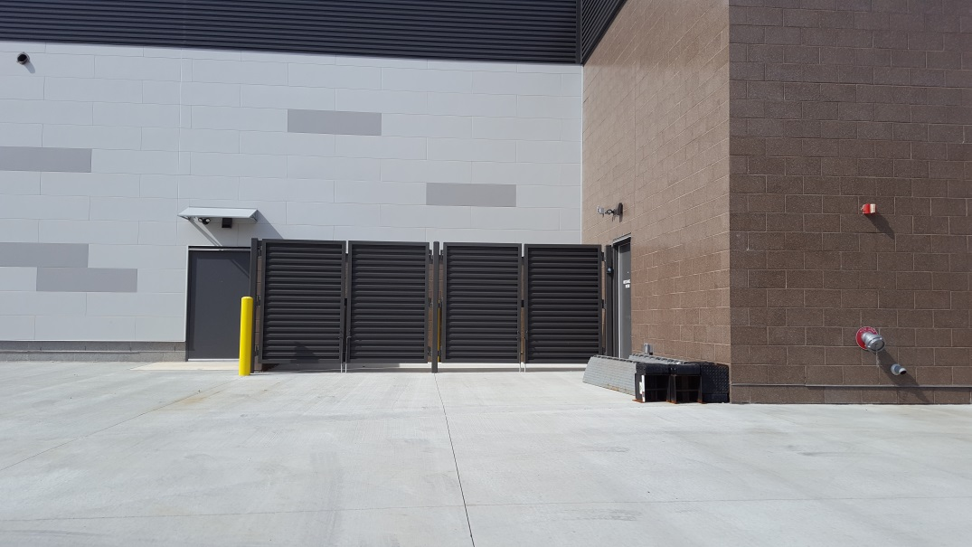
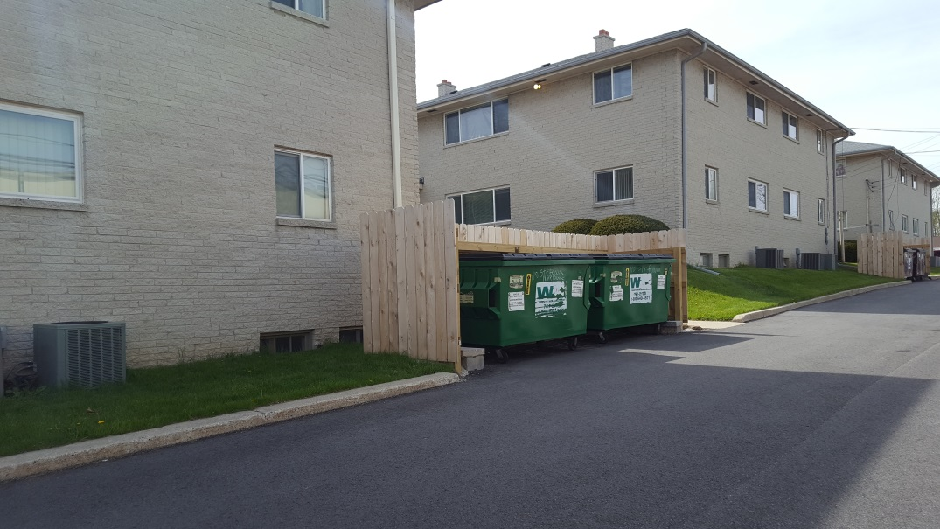
Trash Enclosure Ordinance Overview
New development required to have trash enclosures with materials and colors consistent or complimentary to principal structure.
Clean Rivers, Clean Lake:
Village of Menomonee Falls Trash Enclosures
May 4, 2017

Slide 67
Thank you
Gabriel Gilbertson
Planner
Clean Rivers, Clean Lake:
Village of Menomonee Falls Trash Enclosures
May 4, 2017

Slide 68
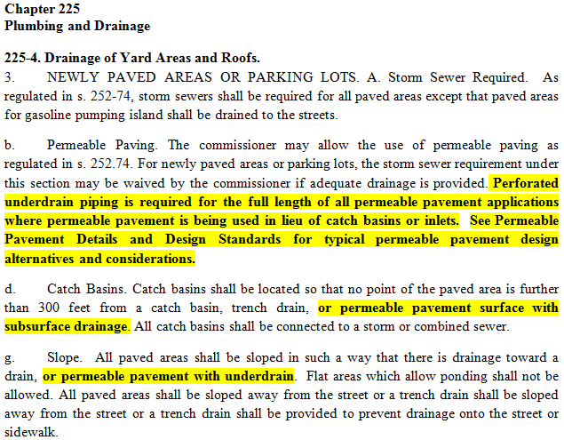

Slide 69
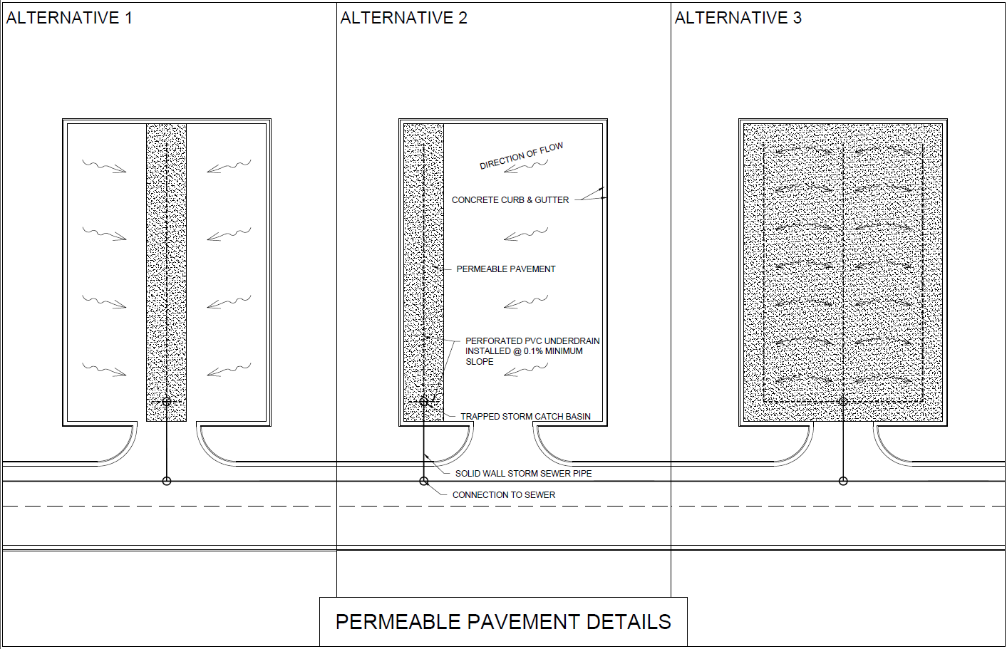

Slide 70
